Slide 1
Prerequisite: Apigee Trial Account Sign-up
https://goo.gl/ALGs3M
Notes:
Post this on group chat
Very important that you complete this step!

Slide 2

Apigee Virtual API Jam
The Hexagon
API-first development with Apigee Edge
‹#›
Notes:
Welcome.
Agenda:
Make sure everyone has signed up and can use Apigee Edge
Talk about Why API Management? What problem does it solve
Then Why Apigee Edge. There are several APIM tools out there, but what differentiates Apigee Edge and makes it a robust APIM solution.
Finally, hands on labs! Test drive the platform...

Slide 3
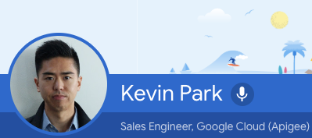
Notes:
My name is...
Technologist for over 13 years.
Many roles: software developer, solution architect and product manager.
Also, helping us today to answer your questions are...
Apigee, part of Google Cloud.
Exciting time to be part of Apigee. Google’s innovation and technologies are being incorporated into Apigee’s product roadmap, which is creating an exciting vision. AI, ML, GCP, etc.

Slide 4
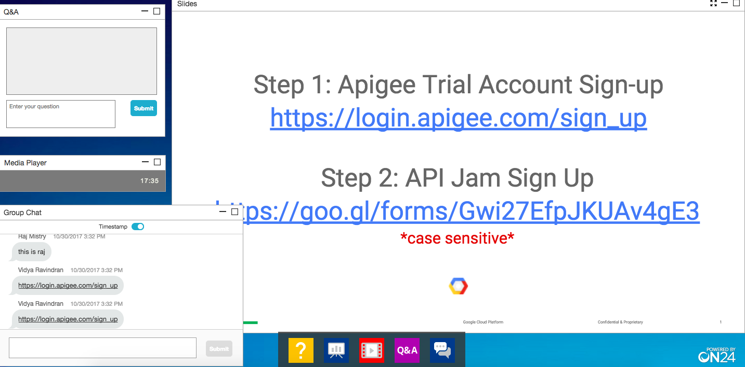
How to use On24:
Use Q&A to ask the instructors your questions.
You must use Chrome or Firefox to use Apigee Edge. Also, ensure you have Adobe Flash installed so you can hear the audio on this On24 webinar. If you just installed Flash, you may need to restart your browser or even your computer.
View Webinar Screen
Use Group Chat to copy links posted by the Apigee team
Notes:
I’ll be the only one speaking.
There will be times where I am not speaking. Nothing wrong with your audio. Just allowing time to work on the labs.
Chrome/Firefox
Flash
Q&A (private, will just go to Apigee team)
Group Chat (public, everyone can see it)

Slide 5
Why API Management?
Notes:
First question we need to explore…
What value does APIM provide?
Why should you use an APIM tool like Apigee Edge?

Slide 6
Success, back in the day...
Integration
CRM, ERP, etc.
Database
Systems of Record
‹#›
Notes:
Enterprise architecture was much simpler.
Fewer systems of engagement
Fewer users (employees)
Fewer systems of record
Point to point integrations, didn’t change much
Internal only, with predictable clients/traffic

Slide 7
The gap
Connected Digital Experiences
Customers
Employees
Partners
ESB / Integration
CRM, ERP, etc.
SOA
Database
Microservices
Data Lake
Systems of Record
‹#›
Notes:
Fast forward to today
Many systems of engagement (thermostats, watches, smart homes, cars, and of course your smartphone, tablet, and laptop too)
Many different types of users (customers, partners along w/ employees)
Many systems of record (legacy plus Big Data)

Slide 8
New demands
Connected Digital Experiences
Days
Customers
Employees
Partners
Pace of change
Secure
Scale
Manage
Analyze
Publish
ESB / Integration
Years
CRM, ERP, etc.
SOA
Database
Microservices
Data Lake
Systems of Record
‹#›
Notes:
With many different types of users using many different types of systems, there are more problems to solve:
Security: how do we ensure the right level of access is given to all of the various clients
How do we make sure that the backend will scale to meet the demand (do we need caching, or do we need to limit the number of requests?)
How do we manage all of the different APIs (versioning, different API responses for different clients, etc)
Visibility/Analytics: we need to know who is using which APIs and which backend services are being used.
Need to connect and route all of the requests to the right systems of record

Slide 9
Bridging the gap
Connected Digital Experiences
Days
Customers
Employees
Partners
Apigee Edge
Pace of change
Secure
Scale
Manage
Analyze
Publish
ESB / Integration
Years
CRM, ERP, etc.
SOA
Database
Microservices
Data Lake
Systems of Record
‹#›
Notes:
This is where an APIM tool like Apigee Edge comes into play.
It provides an independent middle layer or proxy between your many clients and servers.
This is important because you don’t want to put all of the security, scale, etc. in your systems of record/backend because it is hard to do (SORs are slow/difficult to change, hard to replicate changes across all of those disconnected backends, out of sync)
You want a consistent, modular, solution at an itermediate tier that you can implement quickly!

Slide 10
Why Apigee?
Notes:
So now that we know why APIM is important, why Apigee Edge?
There are many vendors and tools in this space, what makes Apigee unique and what are some of its competitive advantages/strengths?

Slide 11
Apigee Covers the ENTIRE Digital Value Chain
Users
Connected Experiences
Developers
APIs
API Team
Backend
Consumption
Exposure
Outside-In Approach
Consumption
Interactive
Unpredictable Usage
Inside-Out Approach
Integration
Transactional
Predictable Usage
‹#›
Notes:
One reason is because Apigee covers the ENTIRE digital value chain.
By DVC, we mean all of the links that make up a digital transaction (users, apps, devs, apis, etc)
Apigee considers all of the links
Apigee thinks of it as OUTSIDE IN, or consumption focused (dev portal, analytics)
EASY for developer to consume APIS and build great apps
Many other vendors in this space just think of exposing backends and that’s it

Slide 12
Apigee technology in brief...
Apigee Edge
Analytics Services
Centralized Governance
Fully Multi-tenant
Self-Service and API First
Multi-Deployment:
On-Premises, Cloud or Hybrid
Cloud Native principles
Enterprise Standards Compliant and Enterprise Grade
Developer Services
Developers
API Team
Management Services
Scalable Services
Management
Runtime
API Services
App
Backend
‹#›
Notes:
One reason is because Apigee covers the ENTIRE digital value chain.
By DVC, we mean all of the links that make up a digital transaction (users, apps, devs, apis, etc)
Apigee considers all of the links
Apigee thinks of it as OUTSIDE IN, or consumption focused (dev portal, analytics)
EASY for developer to consume APIS and build great apps
Many other vendors in this space just think of exposing backends and that’s it

Slide 13





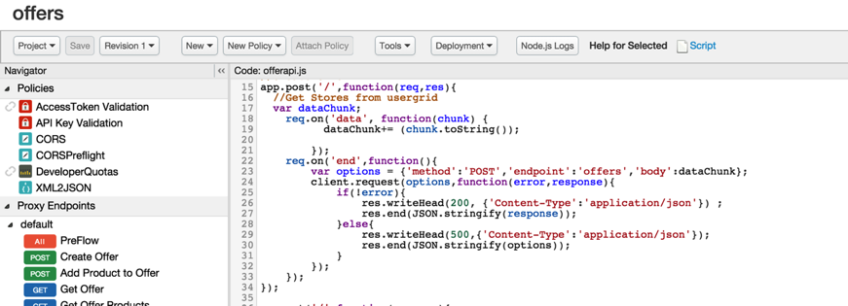
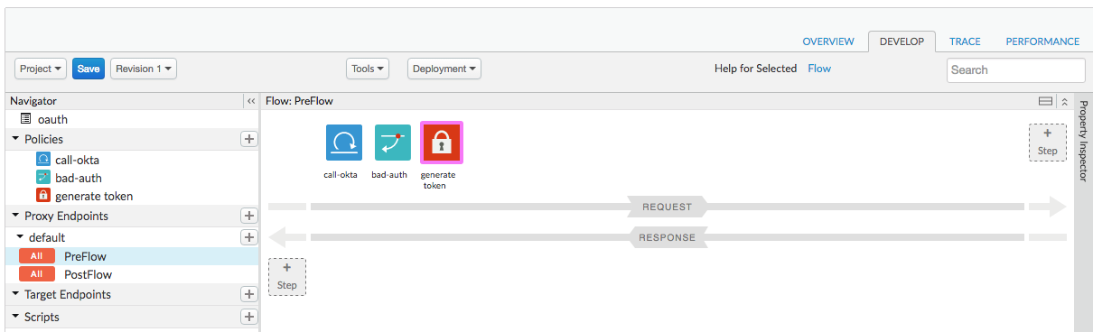
Configuration or Code? Your Choice
Connections, Resources, Security, Quotas, Policies (30+ OOTB)
Configuration Driven Proxy Definition
Code Driven Proxy Definition
Notes:
You will see in the labs today, that it’s easy to build APIs with Apigee Edge. There are plenty of built in policies that you can drag and drop into place to build APIs. If the built in policies don’t do what you need, you can build your own using Node.js, JavaScript, Java, or Python. This lets you build whatever you need. If you need to build something custom, it’s easy and you don’t need to call us.

Slide 14
Analytics Services
Relevant, Actionable and Extensible Dashboards, Tools & Custom Reports
User
App Analytics
Developer Analytics
APIAPI Analytics
Backend
Geolocation
Device
OS
App Performance
App Usage
API Performance
Filter by app version, device, platform, OS, etc.
Top Developers
Developer Engagement
Top API Users
Top Products
Top Apps
API Traffic Patterns
API Performance
Geolocation
Anomalies
Multiple metrics – traffic, response times, errors, data exchange, etc.
Performance
Latency
Errors
Complete visibility from app end to backend.
Automatically and continuously collect all data about your API traffic out of the box.
‹#›
Notes:
Apigee also provides fully featured Analytics
Analytics across the entire digital value chain
Can see which devices users are using, where they are coming from
Which apps are popular
Which developers are building the most engaging apps
API Proxy performance
Backend server performance

Slide 15
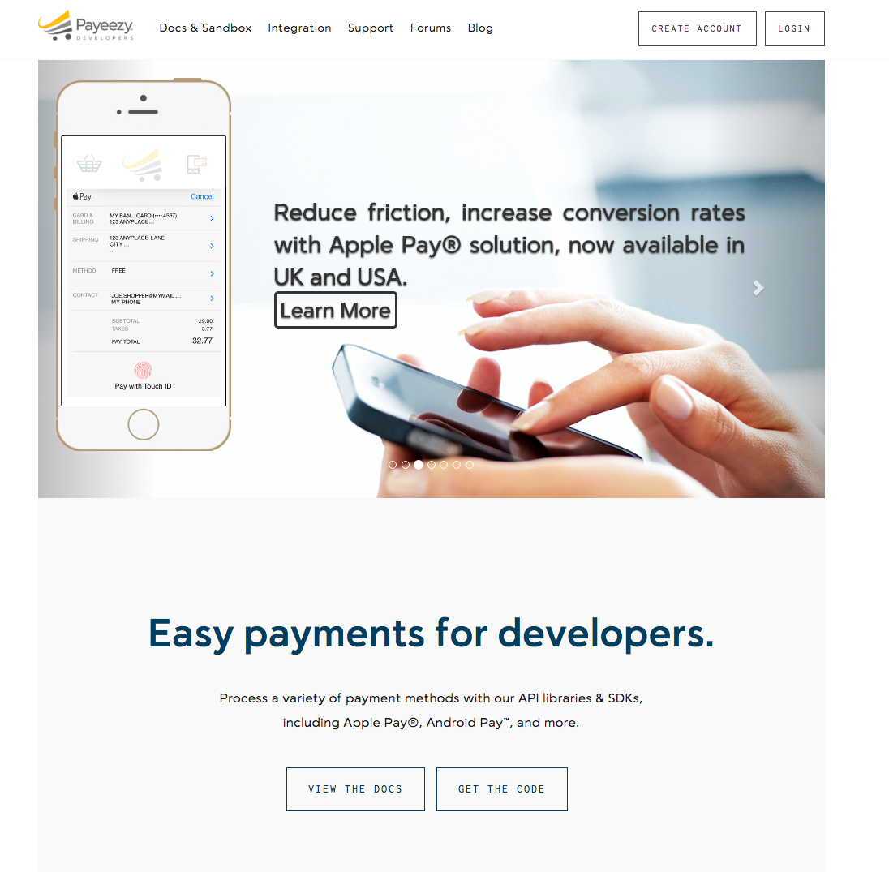
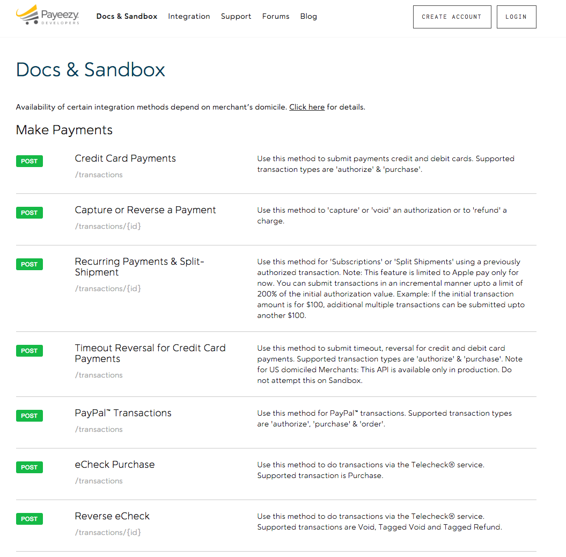
Developer Services – Developer Portal
Streamline API adoption. Empower developers. Build an interactive community.
‹#›
Notes:
Developer Services are key -- Apigee provides two options:
Drupal (fully featured, fully customizable)
Lightweight out of the box portal

Slide 16

One Codebase, Multiple Deployment Choices
MULTI CLOUD
HYBRID
SaaS
ON-PREM
‹#›
Notes:
No lock in!
You have flexibility to move from one deployment option to another
SaaS (fully managed by Apigee, in our cloud)
Multi cloud (your company can deploy Apigee in your favorite cloud provider)
On Prem (your company controls everything, including infrastructure)
Hybrid (runtime API gateway components on prem, management components on the cloud)

Slide 17
























Apigee Edge - Built for APIs, Built with APIs
Developer Services
Analytics Services
Management & OPS Services
API Services
Management API for all platform operations and integrations
https://docs.apigee.com/api-services/content/api-reference-getting-started
Notes:
Chris Lead - Prithpal provide context

Slide 18

Apigee Edge: High Performance API Management
70,000⁺
peak API traffic per sec
99.999%
Multi-Cloud, Hybrid, On-Premises
API availability
24+
availability zones
12+
2B+
regions
transactions/day
Proprietary and confidential
Notes:
Apigee is built to scale
Prove architecture
Black Friday -- 80K TPS
5 9’s

Slide 19






















































































OUR CUSTOMERS
Notes:
Biggest competitive advantage is our customers
Have been privileged to work with so many great brands and companies
Our mature and robust software platform reflects all of these customer experiences
Software has gotten better w/ time because of customer feedback
Built a huge and amazing community -- community.apigee.com -- customers are there talking about their use cases and experiences

Slide 20
Let’s get started…
Log in:
login.apigee.com
API Jam Materials:
https://goo.gl/yw59Hk

Slide 21
Please Complete Lab 1: https://goo.gl/qGc4Gm
Instructor will remain quiet while you are working.
If you have questions, please post them in the Q&A section.

Slide 22
Please Complete Lab 2: https://goo.gl/TAkP3f
Instructor will remain quiet while you are working.
If you have questions, please post them in the Q&A section.

Slide 23
Please Complete Lab 3: https://goo.gl/7a55Ho
Instructor will remain quiet while you are working.
If you have questions, please post them in the Q&A section.

Slide 24
Please Complete Lab 4: https://goo.gl/VMGDpD
Instructor will remain quiet while you are working.
If you have questions, please post them in the Q&A section.

Slide 25
Please Complete Lab 5: https://goo.gl/bqzpcn
Instructor will remain quiet while you are working.
If you have questions, please post them in the Q&A section.

Slide 26
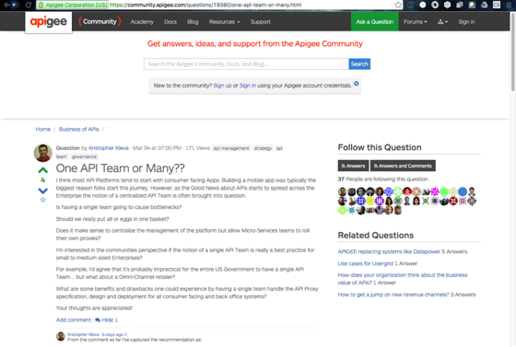
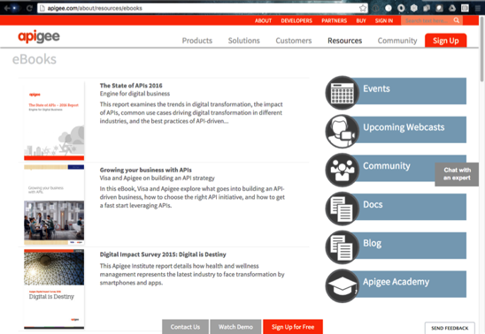
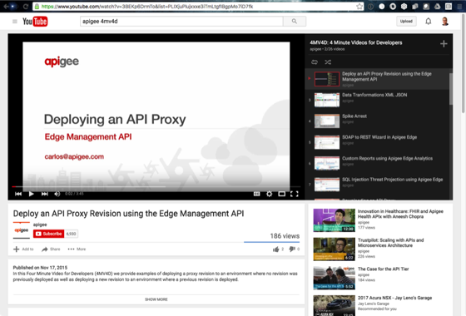
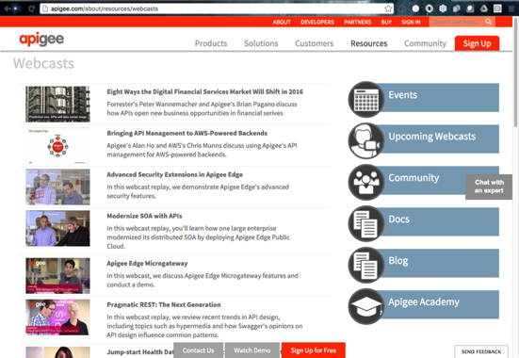
Thought Leadership
community.apigee.com
4MV4D – 4 minute videos for developers
Webcasts
eBooks
Annual API Conferences
Notes:
Apigee is a thought leader in the API management space. If you visit our website, you’ll find numerous customer stories, ebook, videos, webcasts, etc. We also have a very active user community on community.apigee.com where over 5000 of our users talk about our product—for better or worse, asking questions and getting answers from Apigee and from other users. We publish 4 minute videos on specific features.

Slide 27
Feedback Please!
https://goo.gl/NehmdR
*case sensitive*

Slide 28
Links to Remember
4 Minute Videos 4 Developers: https://goo.gl/QxxyWh
Apigee Certification: https://goo.gl/2AmLRe
Coursera API Developer Training: https://www.coursera.org/specializations/apigee-api-gcp
Coursera API Operations Training: https://www.coursera.org/specializations/apigee-api-gcp-onprem
Apigee Community: https://community.apigee.com/
Apigee documentation: https://docs.apigee.com/
Developer Tools: https://apigee.com/about/developers

Slide 29
Thank you

Slide 30


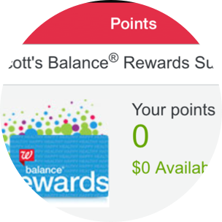

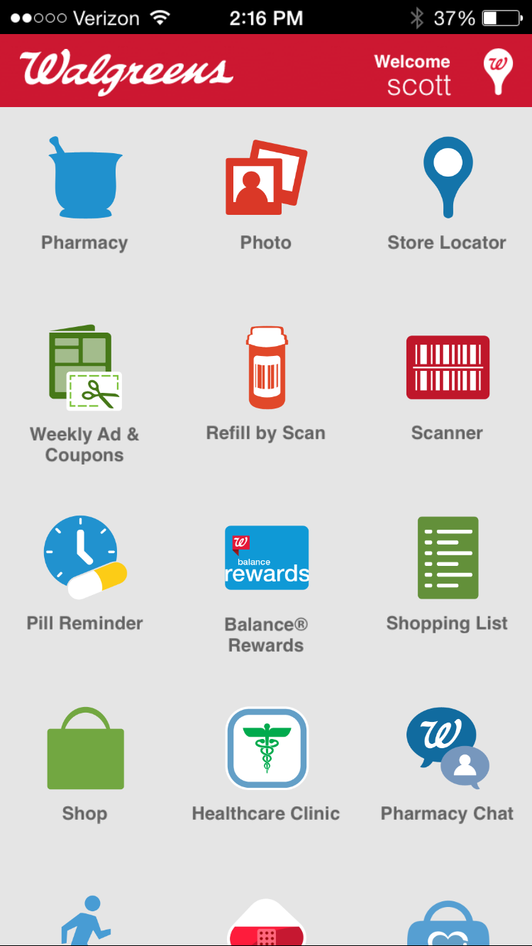
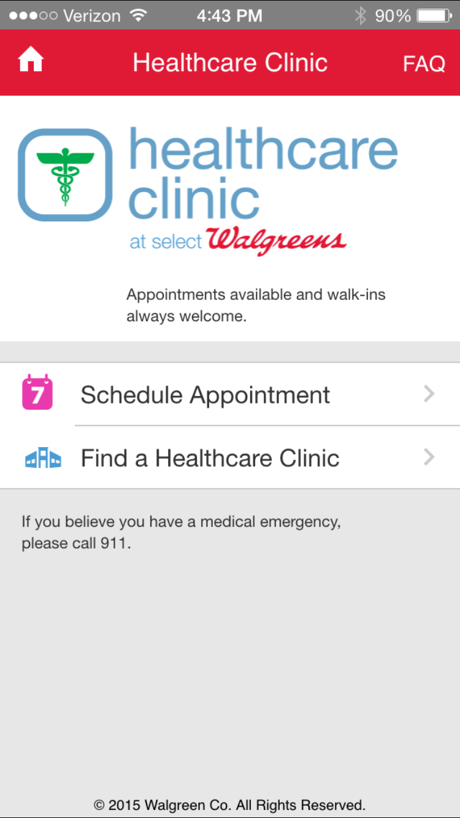

APIs enable omnichannel business
uy More
rds
Buy More
print photos in store
Balance® Rewards API
Photo Prints API
Rewards
earn on checkout
ert
Alert
prescription refill ready
Prescription API
Schedule
flu shot in clinic
Scheduler API

Slide 31
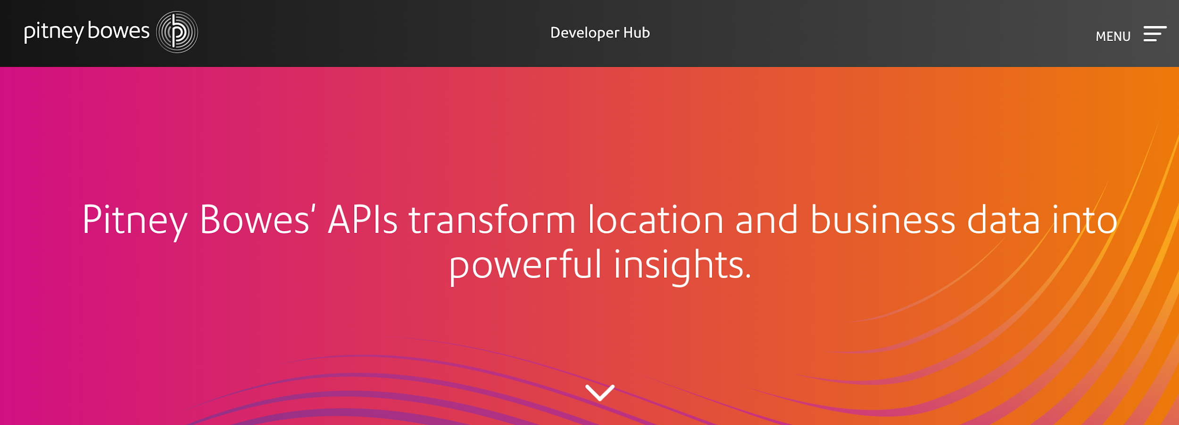
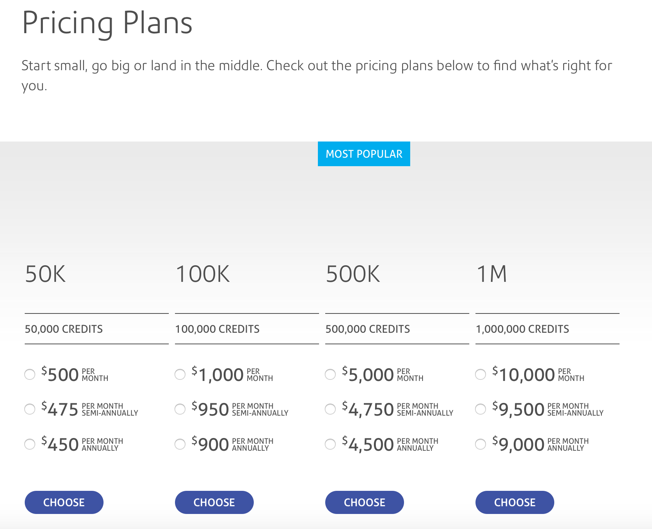
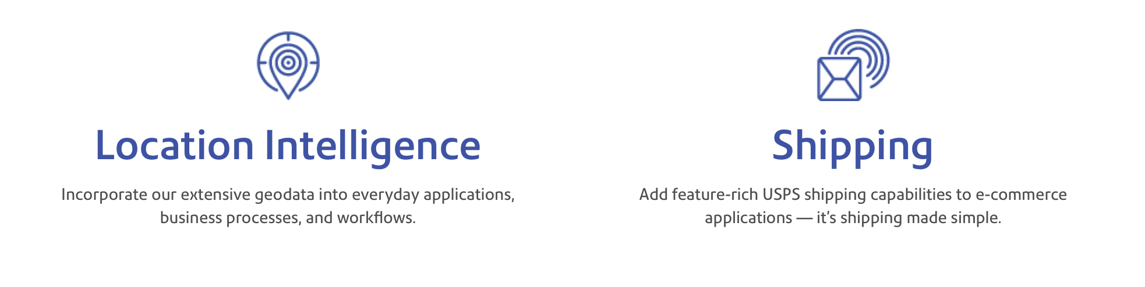
APIs enable innovative reach & revenue

Slide 32
Products, Apps and Developers
Products bundle together API proxies to offer them to Developers.
Developers are external API users who interact with your APIs by developing applications that use them. Developers may be grouped into Companies.
Apps are associations between Developers and Products.
Developer
App
Keys
Product
API Proxy A
API Proxy B
‹#›

